Slide 1
Project Meeting
IoT Group_2019.05.17

Slide 2
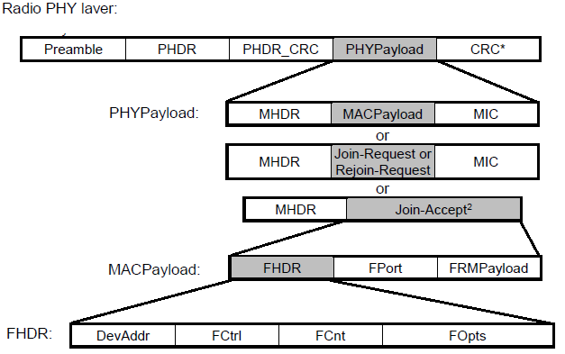
Performance of Raspberry pi execution
Packet: 267 bytes * 200
Buffer size: at least 53400 bytes
7-255
8
2
4bit
7-255
2
Bytes
1
7-M
4
7-22
0-1
0-N

Slide 3
Project meeting
IoT Group
2019.05.31

Slide 4
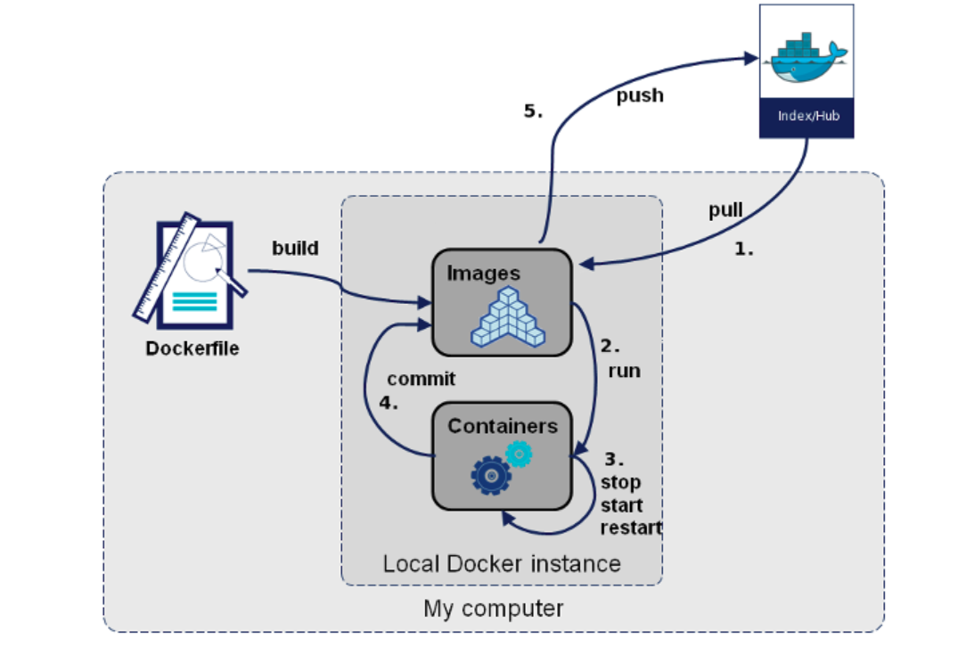
Docker Flow
Docker Registry : Docker Hub Registry
commit
save
export

Slide 5
Progress Work
Build an image for TensorFlow and Keras using Dockerfile without exporting the container
Preprocess the dataset

Slide 6
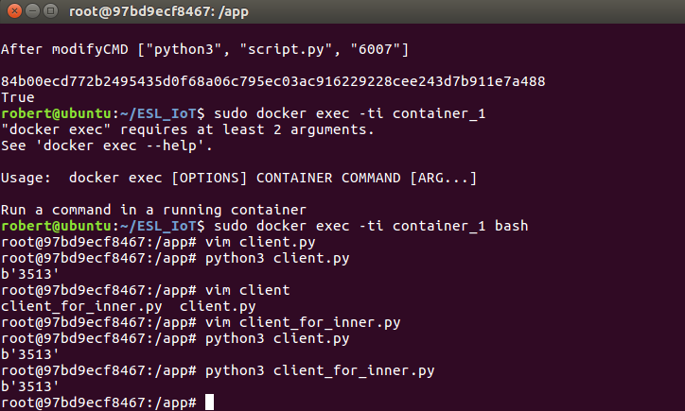
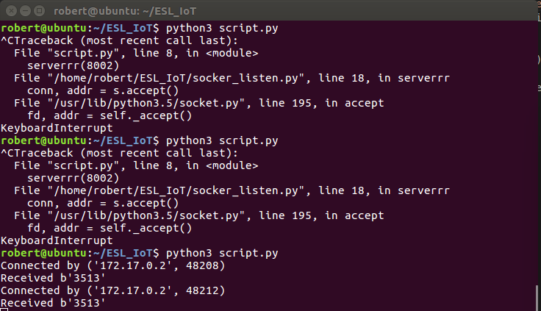
Send data from container to host
Container_1
HOST

Slide 7
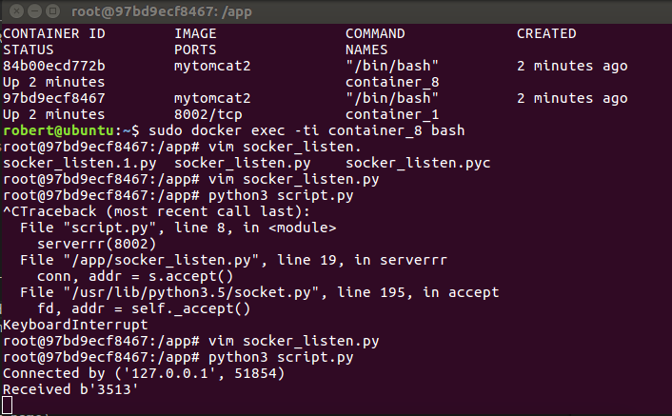
Send data between Container_1 and Container_2
Container_2
Container_1

Slide 8
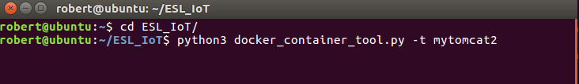
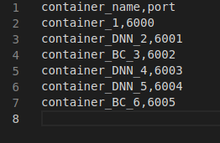
Add new command
1
2

Slide 9
Project meeting
IoT Group
2019.05.31

Slide 10
Docker Flow
Docker Registry : Docker Hub Registry
commit
save
export

Slide 11
Progress Work
Build an image for TensorFlow and Keras using Dockerfile without exporting the container
Preprocess the dataset

Slide 12
Send data from container to host
Container_1
HOST

Slide 13
Send data between Container_1 and Container_2
Container_2
Container_1

Slide 14
Add new command
1
2

Slide 15
Project meeting
IoT Group
2019.06.12

Slide 16
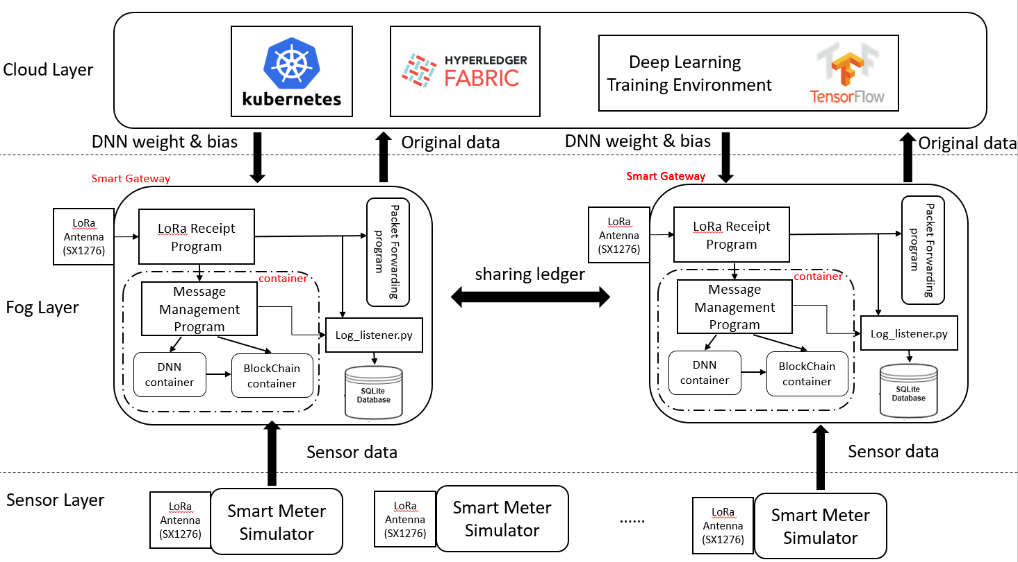
IoT Architecture

Slide 17
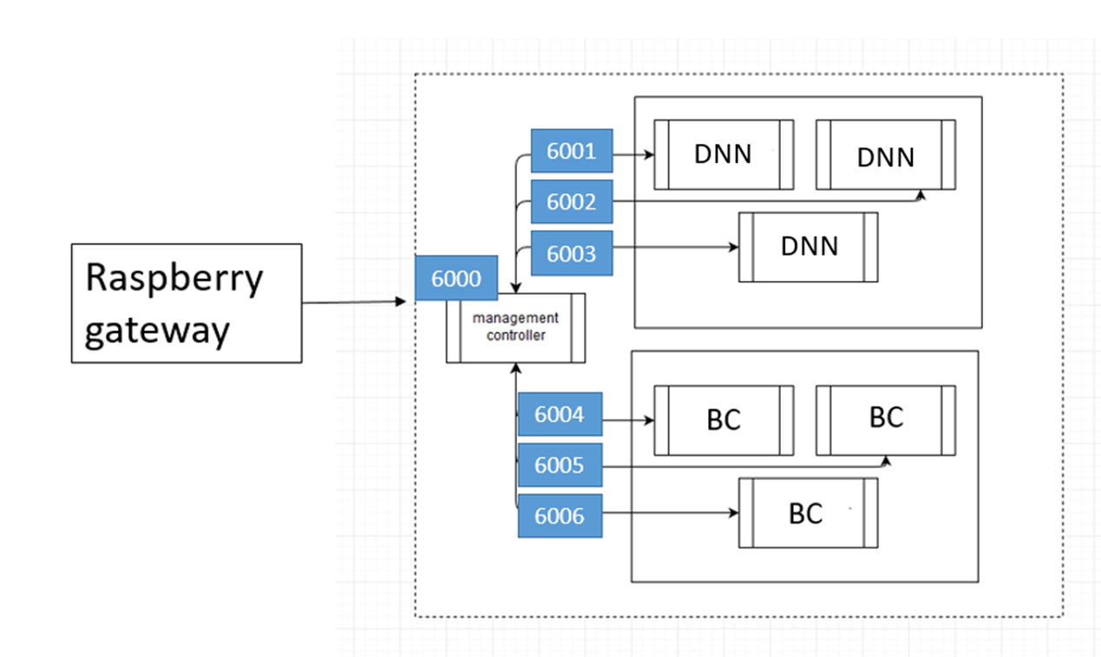
Docker Inner Network

Slide 18
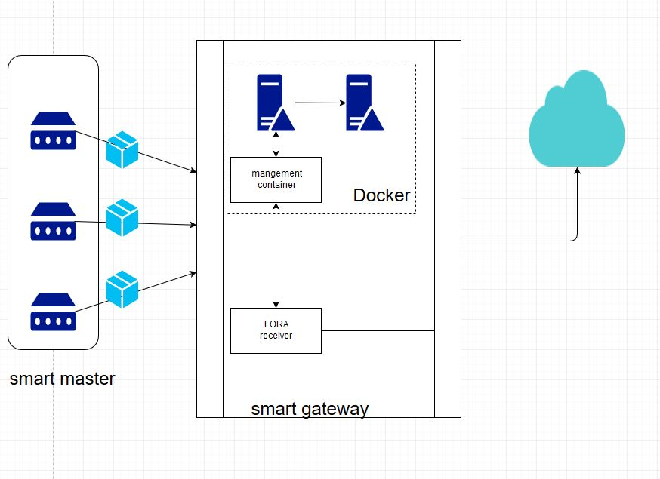
System architecture
Smart meter

Slide 19
System architecture
LoRaWAN
LoRa Sensor node ( Raspberry Pi 3 )
LoRa Gateway ( Raspberry Pi 3 )
LoRa
Antenna
(SX1276)
LoRa
Antenna
(SX1276)
LoRa receipt.py
LoRa transmission.py
Message
Management program
Smart meter
Simulator.py
DNN container
Smart meter Dataset.csv

Slide 20
System architecture of Buffer
Message Management
management
container
Buffer Rearder
Buffer
LORA Receiver

Slide 21
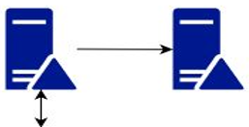
Receiver Buffer on Smart Gateway
Payload
Compare Payload ID
Space 1
Space 2
Payload 1
Payload 1
Payload 2
30min
200 smart meters
Payload 3
management
container
Docker
Buffer Reader
Message Management

Slide 22
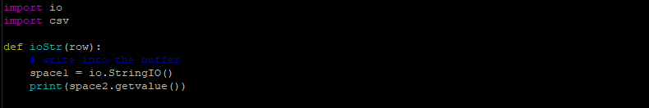
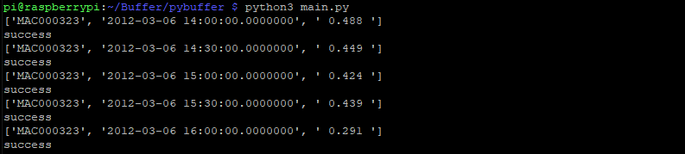
Program
String IO
Result of Test

Slide 23
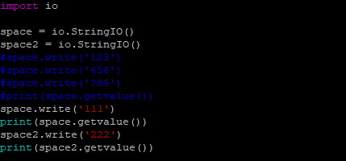

Problem
What is String IO ?
Why don’t I use Array?
Can I creat two String IO ?

Slide 24
System architecture

Slide 25
Buffer flow
Data_1
DNN
Data
Data_1
request
Data_2
DNN
Data_3
DNN
Mangement container

Slide 26
Input data flow
Input data
check array
Checking array[index] have same or not
check function
Index ++
Yes
No
Buffer_array
Push function

Slide 27
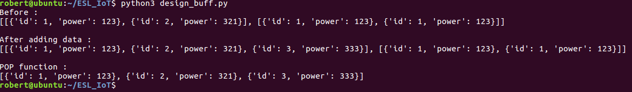
Buffer function
completed function:
search function
Pop function
Push function
check_buffer_size
show_buff
Will do function:
get_request_enter_container

Slide 28

Proposed Architecture for Log Data
Smart Gateway
LoRa Antenna
(SX1276)
LoRa Receipt
Program
Packet Forwarding program
container
Message
Management Program
Log_listener.py
DNN
container
BlockChain
container

Slide 29
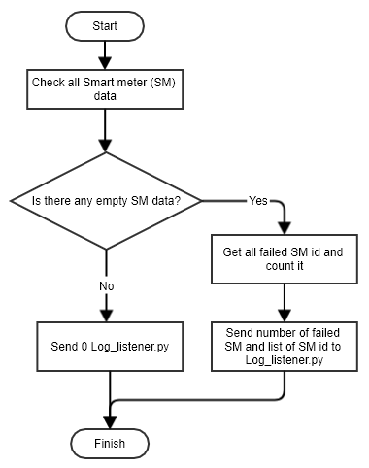
Flowchart for LoRa receiver log

Slide 30
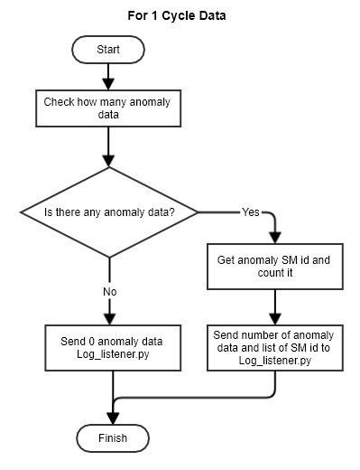
Flowchart for DNN log

Slide 31
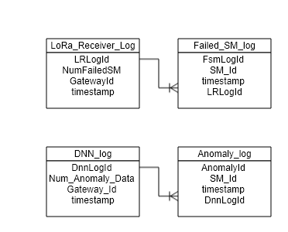
Database Design

Slide 32
Project meeting
IoT Group
2019.06.26

Slide 33
IoT Architecture

Slide 34
Proposed Architecture for Log Data
Smart Gateway
LoRa Antenna
(SX1276)
LoRa Receipt
Program
Packet Forwarding program
container
Message
Management Program
Log_listener.py
DNN
container
BlockChain
container

Slide 35
Flowchart for LoRa receiver log

Slide 36
Flowchart for DNN log

Slide 37
Database Design

Slide 38
System architecture of Receiver Buffer
Message Management
management
container
Buffer Rearder
LORA Receiver
Buffer

Slide 39
Receiver Buffer on Smart Gateway
Payload
Space
30min
Step by step
200 smart meters
Payload 1
Payload 2
Payload 3
management
container
Docker
Message Management
Buffer Reader

Slide 40
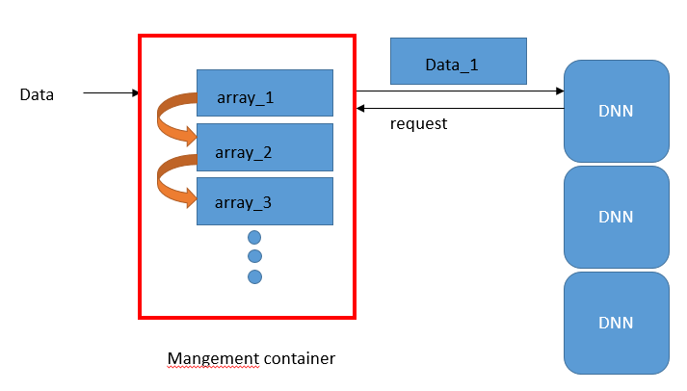
Buffer flow

Slide 41
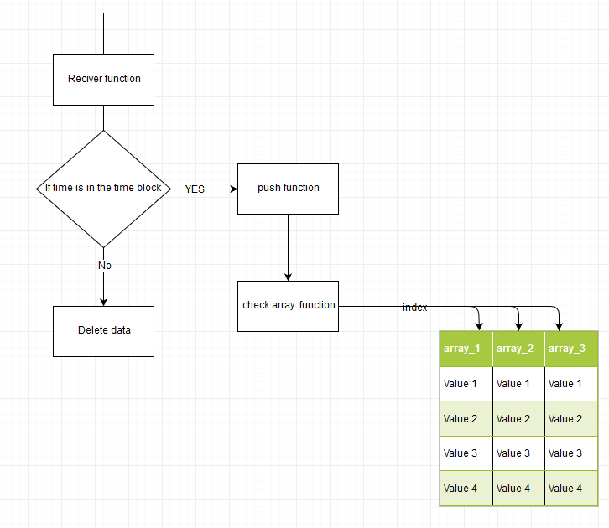
Modify Buff

Slide 42
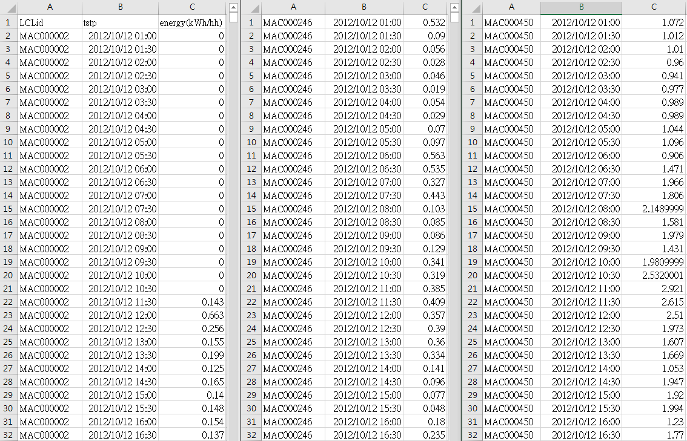
Dataset
Notes:
5600

Slide 43
Project Meeting
2019/07/03

Slide 44
LoRa Buffer
respberry
Receiver
smart meter
package
smart gateway
Payload 1
package
Payload 2
Payload 3
package
queue
Transform into str
analyze

Slide 45
Container Buffer
Transform into str
smart gateway
Management Container

Slide 46
System architecture of Smart Gateway Receiver to DNN container
Receiver
Buffer
Data Transmission
LoRa Receiver.py
Docker
management
container
DNN container
smart gateway ( Raspberry Pi 3 )

Slide 47
IoT Architecture

